Slide 1
The case for gold in the Liquidity Coverage Ratio

Slide 2
Disclaimer
This presentation is provided solely for general information and educational purposes. It is not, and should not be construed as, an offer to buy or sell, or as a solicitation of an offer to buy or sell, gold, any gold related products or any other products, securities or investments. It does not, and should not be construed as acting to, sponsor, advocate, endorse or promote gold, any gold related products or any other products, securities or investments.
This presentation does not purport to make any recommendations or provide any investment or other advice with respect to the purchase, sale or other disposition of gold, any gold related products or any other products, securities or investments, including without limitation, any advice to the effect that any gold related transaction is appropriate for any investment objective or financial situation of a prospective investor. A decision to invest in gold, any gold related products or any other products, securities or investments should not be made in reliance on any of the statements in this presentation. Before making any investment decision, prospective investors should seek advice from their financial advisers, take into account their individual financial needs and circumstances and carefully consider the risks associated with such investment decision.
While the accuracy of any information communicated herewith has been checked, neither the World Gold Council nor any of its affiliates can guarantee such accuracy. In no event will the World Gold Council or any of its affiliates be liable for any decision made or action taken in reliance on the information in this presentation or for any consequential, special, punitive, incidental, indirect or similar damages arising from, related to or connected with this presentation even if notified of the possibility of such damages.
Expressions of opinion are those of the author and are subject to change without notice.

Slide 3
Context
Regulators around the world are in the process of writing new proposals to introduce or amend rules on the amount of high quality liquid assets that commercial banks must hold.
This is part of the Basel III regulations.
This presentation looks at the case for gold as a high-quality liquid asset.

Slide 4
The case for gold as a high quality liquid asset

Slide 5
Gold has no credit risk
Gold is not issued.
It has no credit risk.
If a commercial bank buys gold it would be held on an “allocated basis” (meaning the bank owns specific bars identified by a serial number) by a custodian.
As the gold is “allocated” it is not on the custodian’s balance sheet. If the custodian were to go bankrupt the gold could easily be identified by the serial numbers – unlike cash balances.

Slide 6
Sovereign risk is non zero risk
Notes:
Ask a question, who hasn’t defaulted?

Slide 7
Gold has committed market makers – the London OTC market
LBMA market makers by product
 | Spot | Forwards | Options
The Bank of Nova Scotia | X | X
Barclays Bank Plc | X | X | X
Credit Suisse | X |  | X
Deutsche Bank AG | X | X | X
Goldman Sachs International | X | X | X
HSBC Bank USA NA | X | X | X
JP Morgan Chase Bank | X | X | X
Merrill Lynch Bank International Ltd |  |  | X
Mitsui & Co Precious Metals | X
Societe Generale | X | X | X
UBS AG | X | X | X
Source: LBMA

Slide 8
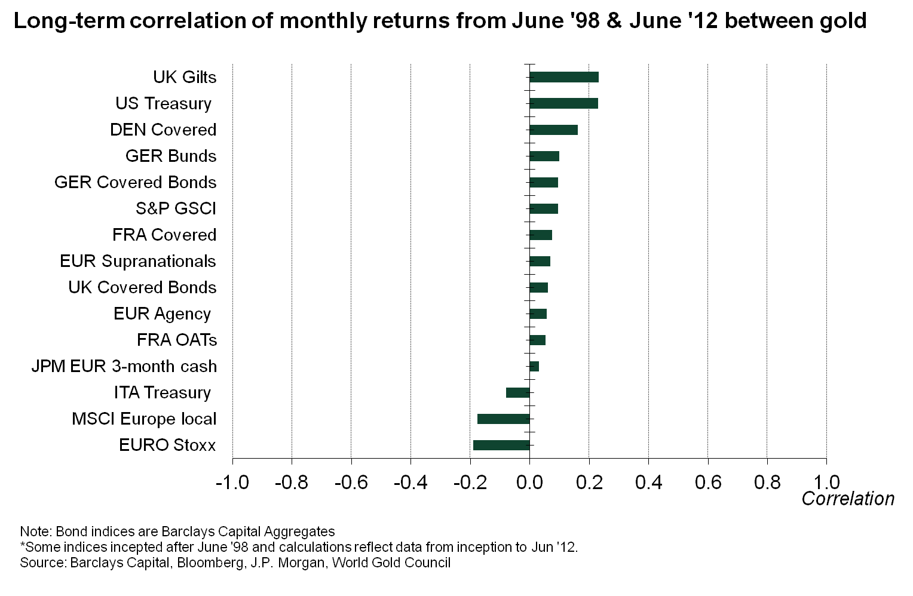
Gold is not correlated with other LCR assets

Slide 9
This reflects the diversity of supply and demand

Slide 10

The gold market is deep
20.8m
Other² 24,800t 14%
Total above ground stocks
= 174,100 tonnes (US$9.6 trillion)¹
Jewellery 84,600t 49%
Official sector 30,100t 17%
20.8m
Private investment 34,700t 20%
Below ground stocks 52,000t
1 Based on end-2012 volume and Q4 2012 average gold price of US$1,721.8/oz.
2 Includes “other fabrication” (12%) and “unaccounted for” (2%).
Note: Totals may not sum due to independent rounding.
Source: Thomson Reuters GFMS, US Geological Survey, World Gold Council

Slide 11
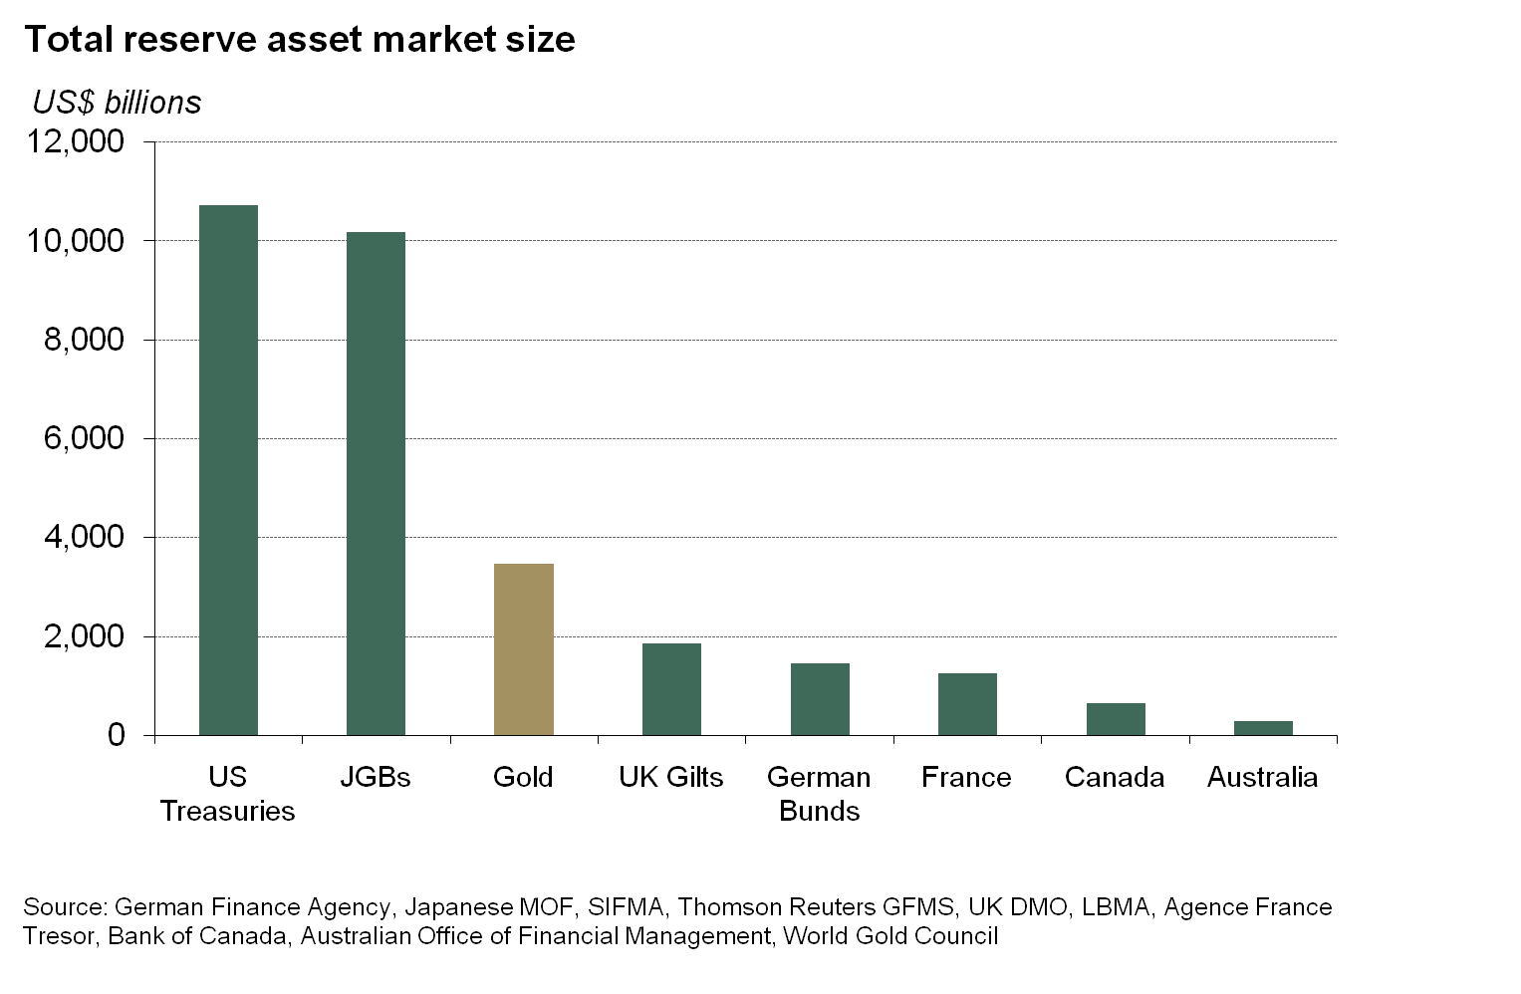
Gold versus outstanding bond issuance
Notes:
Insert quiz.

Slide 12
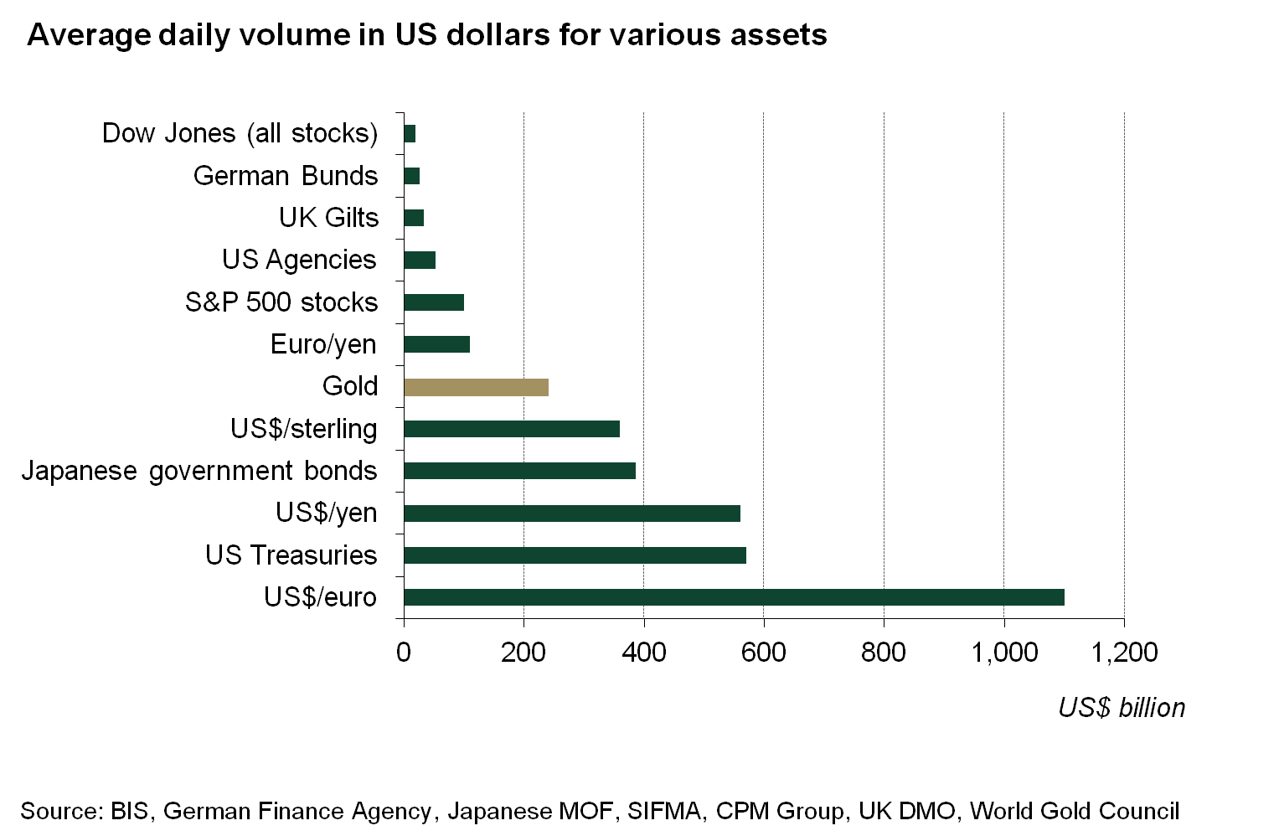
$240 billion daily volume—topping most other assets

Slide 13
Gold performs well during liquidity stress periods
As a general framework to uncover liquidity stress periods we examined instances when the Euro FX basis swaps widened significantly. There were 7 discreet periods that the basis swaps pointed toward as potentially funding pressures in Europe. These instances were cross checked against 10 instances when Euribor-Eonia also widened by a rate greater then 2.5 standard deviations in a given week. Three periods were excluded where Euriobor-Eonia widened and the FX basis did not. Those were a rate hike by the ECB and 2 sub-prime related events that were more US specific.
Lehman bankruptcy (12/9/2008 – 3/10/2008): One of the largest US financial institution collapses sending markets into turmoil
European rating downgrades (13/2/2009 – 27/2/2009): In the midst of an ECB easing cycle the ratings of Spain and Greece are cut in late January. G7 and European leaders meet in Early February to discuss to examine stability and convergence programmes
Greek fiscal problems discovered (30/10/2009 – 27/11/2009): On 5 November New Greek Prime Minister, George Papandreou, announces that Greece’s annual budget deficit will be 12.7% of GDP — more that twice the previously announced figure.
European debt crisis (30/04/2010 – 07/05/2010): The European sovereign debt crisis takes center stage as European leaders agree to EFSF and EUR110bn Greek rescue package
Irish bailout: Irish debts sell off as anxiety about an Irish sovereign debt interest payment holiday grips bondholders. On 16 November Irish bailout talks begin. Private Sector Involvement in restructurings becomes prominent issue.
Greek bailout restructured (16/09/2011 – 04/11/2011): On 19 September Italy downgraded along with 24 Italian banks. European sovereign spreads peak. IMF Fifth review of Greece released. Papandreou calls for euro referendum
Greek elections (18/05/2012 – 22/06/2012): Greece fails to form a coalition government. In early June, Spain announces will make formal request for aid to shore up banks.

Slide 14
Gold was the best performing asset in most stress periods
Event | Beg Date | End Date | Gold | Bunds | OATs | Italian | UK Gilts | US Treasury | Euro Agency | Euro Supra | Covered | Cash
Lehman bankruptcy | 9/12/2008 | 10/3/2008 | 13.47% | 2.19% | 2.01% | 1.78% | 4.03% | 3.87% | 1.27% | 1.72% | 0.41% | 0.23%
European rating downgrades | 2/13/2009 | 2/27/2009 | 3.08% | -0.19% | -0.43% | -0.12% | -0.87% | 1.14% | 0.01% | 0.19% | -0.21% | 0.12%
Greece fiscal problems discovered | 10/30/2009 | 11/27/2009 | 10.48% | 0.80% | 0.74% | 0.40% | -0.81% | -0.24% | 0.53% | 0.62% | 0.58% | 0.08%
EFSF launch | 4/30/2010 | 5/7/2010 | 6.50% | 1.38% | 0.94% | -2.11% | 1.69% | 6.27% | 0.14% | 0.58% | -0.57% | 0.01%
Irish bailout | 11/5/2010 | 11/12/2010 | 2.42% | -0.50% | -0.61% | -1.12% | 0.50% | 1.45% | -0.39% | -0.65% | -0.63% | 0.03%
Greece bailout restrucutured | 9/16/2011 | 11/4/2011 | -2.49% | 0.54% | -2.38% | -4.17% | 4.55% | 0.96% | -0.24% | -0.69% | 0.70% | 0.27%
Greece elections | 5/18/2012 | 6/22/2012 | -0.19% | -0.67% | 1.38% | 0.20% | 1.15% | 1.66% | 0.79% | 0.46% | -0.54% | 0.12%
Average |  |  | 4.75% | 0.51% | 0.24% | -0.73% | 1.46% | 2.16% | 0.30% | 0.32% | -0.04% | 0.12%

Slide 15
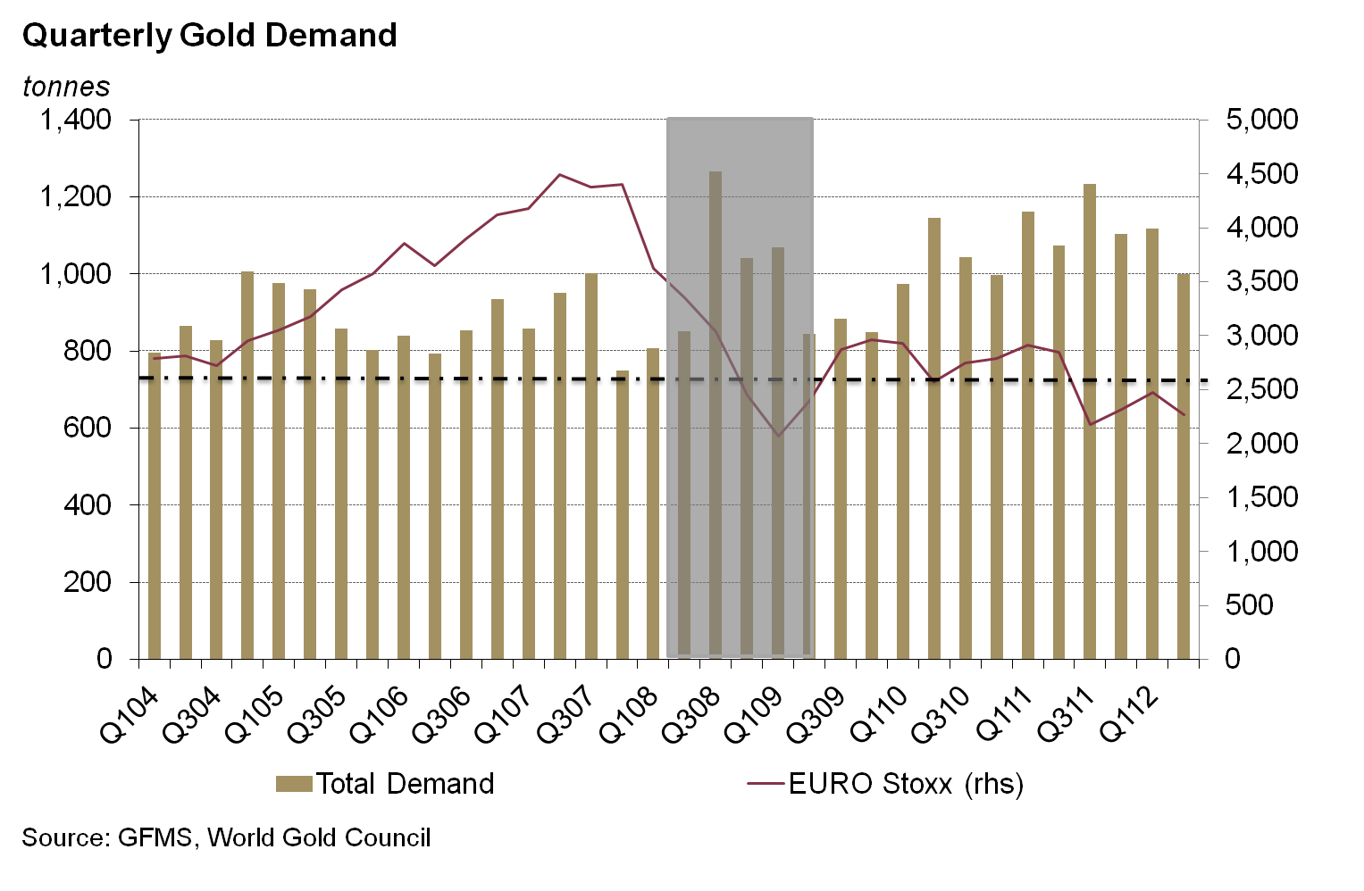
Demand for gold increases during crisis periods

Slide 16

Thank you
For questions please email:
Reserve_Asset@Gold.org
World Gold Council
10 Old Bailey
London EC4M 7NG
T +44 207 826 4700
F +44 207 826 4799
W www.gold.org

